Slide 1
Fake vs Real: Deepfake Audio Detection
Ashley S. Nguyen Kimberly P. Nguyen Taylen Washington

Slide 2

Background and Motivation
Artificial intelligence has made it possible to generate highly realistic human like voices using text-to-speech technologies. While these advancements are useful for applications such as virtual assistants and accessibility tools, they also introduce serious risks.
Synthetic speech can be used for impersonation, fraud, and the spread of misinformation, making it difficult to determine whether an audio recording is real or fake.
The goal of this project is to develop machine learning models that can automatically classify audio recordings as either real human speech or AI-generated speech.

Slide 3




Dataset Overview
Dataset Info
Problem Type
Fake-or-Real (FoR) Audio Dataset (Kaggle)
Contains real human speech and AI-generated (fake) speech
Binary classification problem
Real vs Fake
Data Structure
Data Summary
Organized into folders:
Real
Fake
Audio format: .wav
Dataset is fairly balanced
Average duration:
Real: ~5.39 sec
Fake: ~2.36 sec
Difference: ~3.03 sec

Slide 4
Technical Challenges: Audio Duration Bias
Real audio is ~3 seconds longer on average
Risk: model may learn duration instead of speech patterns
Solution: convert audio to fixed-size features
Used MFCC + fixed-size mel-spectrograms
It’s important that the model focuses on patterns, not length

Slide 5


Method Overview
Traditional Machine Learning
Deep Learning
MFCC Features (Mean + Std)
Random Forest
Support Vector Machine (SVM)
Logistic Regression
Mel Spectrograms
CNN Model
Learns patterns from audio
Pipeline
Audio → Features → Model → Prediction

Slide 6
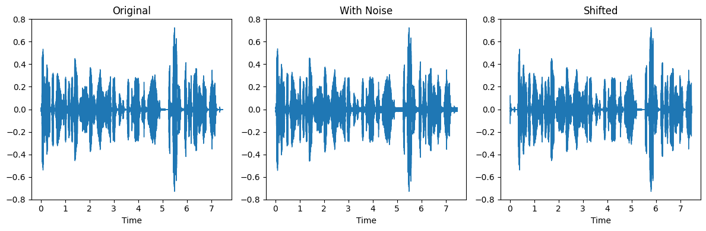


Data Augmentation
Applied data augmentation by adding noise and shifting audio to create additional training samples.
Each original audio file is transformed into multiple versions to improve model generalization.
Noise
Shift
Adds small, random variations to the audio signal
Moves the audio slightly in time, preserving the speech
These subtle changes help CNN learn more general patterns and improve performance on unseen data.

Slide 7
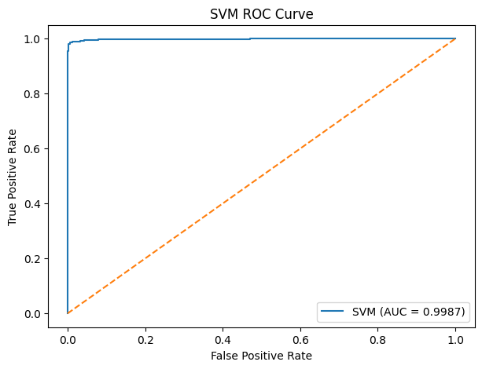
Traditional ML Results
Accuracy:
F1:
Logistic Regression: | ~91.49% | ~91.41%
Random Forest: | ~97.74% | ~97.73%
SVM: | ~92.54% | ~92.33%
Logistic Regression (Scaled): | ~91.54% | ~91.46%
SVM (Scaled): | ~98.84% | ~98.84%
Feature scaling significantly improved SVM performance, making it the best model.

Slide 8
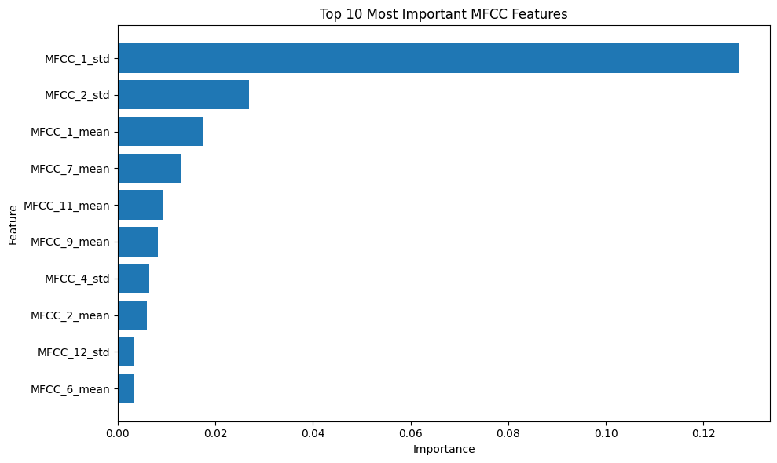
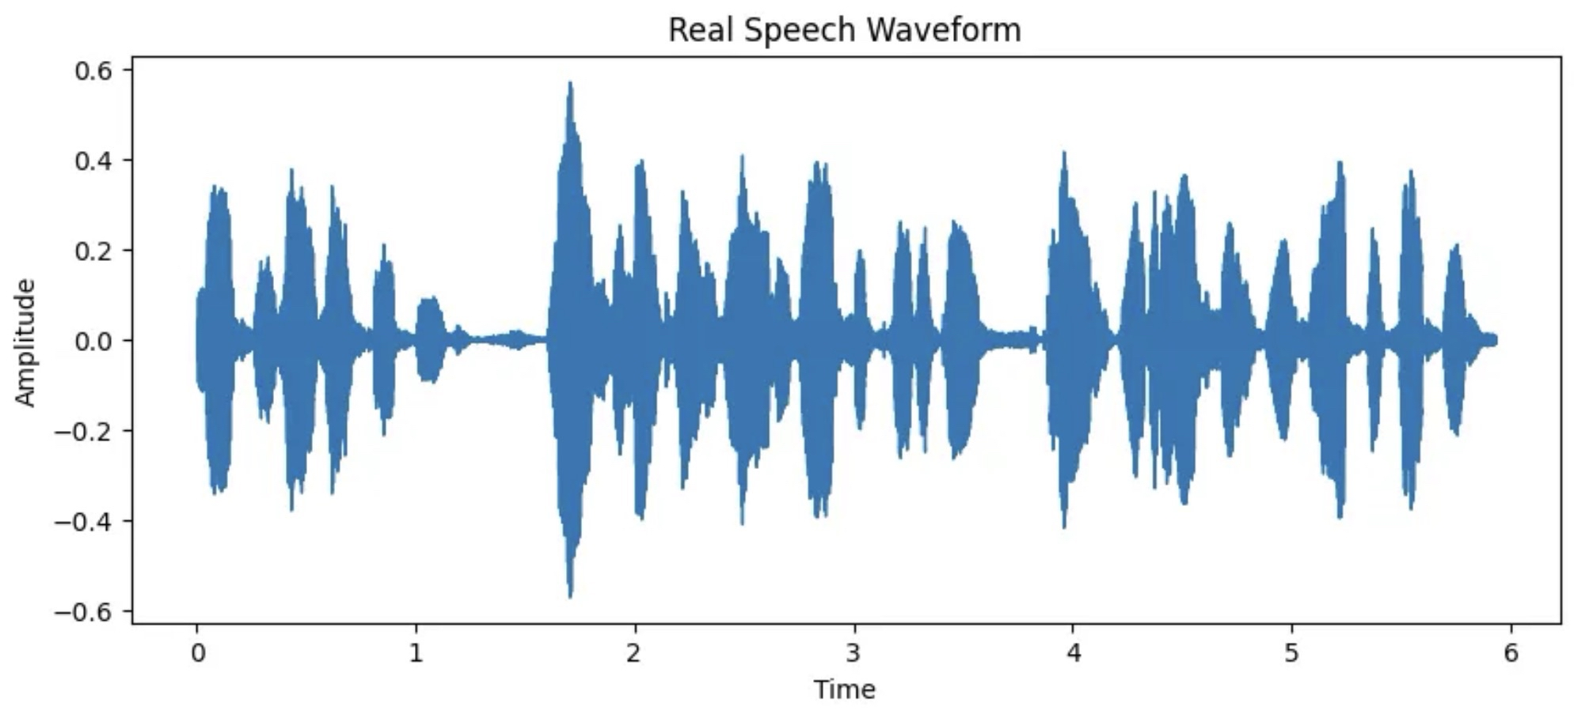
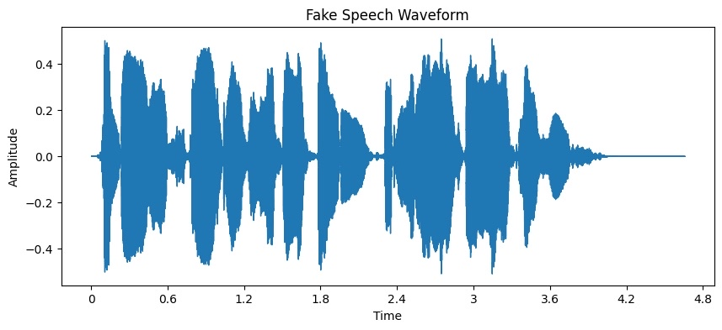
Feature Importance
What we did
Extracted MFCC features from audio.
We used:
Mean: The average frequency content.
Standard Deviation: The variation over time.
Key Insight
Most important features is MFCC standard deviation.
Captures how audio changes over time.
Why it matters
Real speech is more natural variation
Fake speech is often smoother

Slide 9
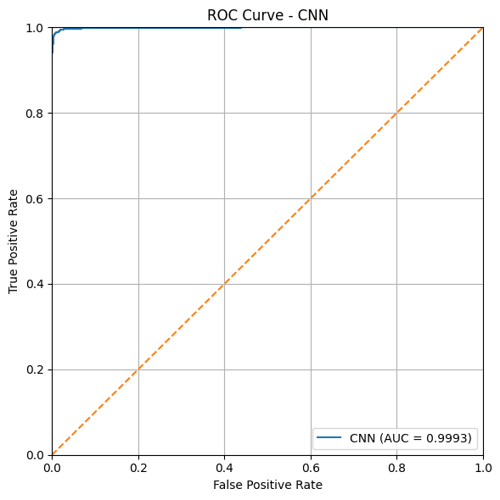
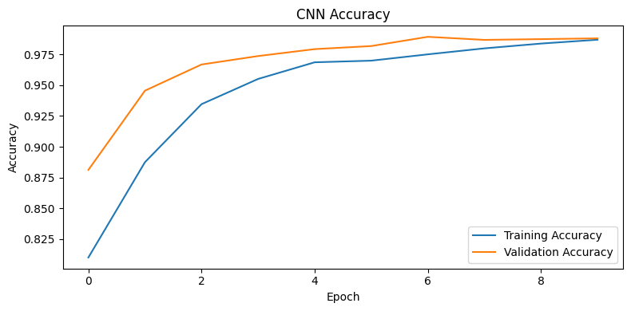
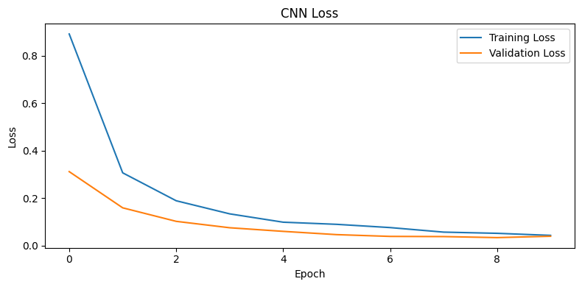
CNN Results
Training converged quickly in just a few epochs.
Accuracy: ~98.82%
F1: ~98.81%
ROC curve evaluates classification performance
AUC ≈ 0.9993
Strong separation between real and fake audio

Slide 10
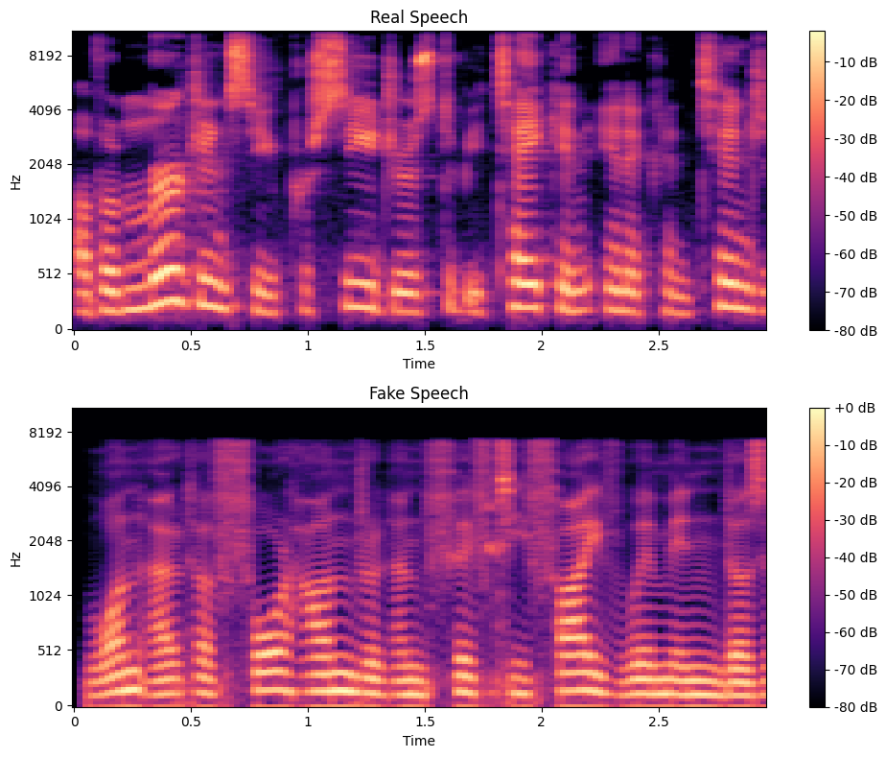
CNN’s Pattern Learning
What CNN does
Converts audio to Mel spectrograms (2D images)
Learns patterns in spectrograms
Automatically detects real vs fake speech
Key Insight
CNN focuses on unique visual differences between real and fake speech
Trains directly on spectrogram images instead of manual features
Why it matters
Real and Fake speech have distinct patterns in the spectrograms
Fake speech often has smoother, less natural patterns

Slide 11
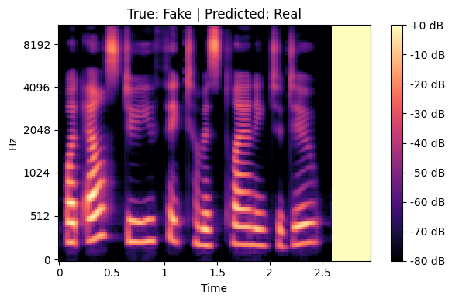
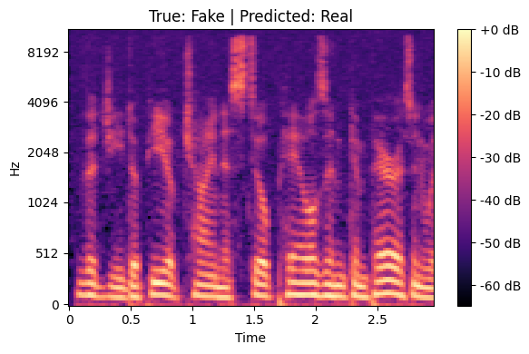
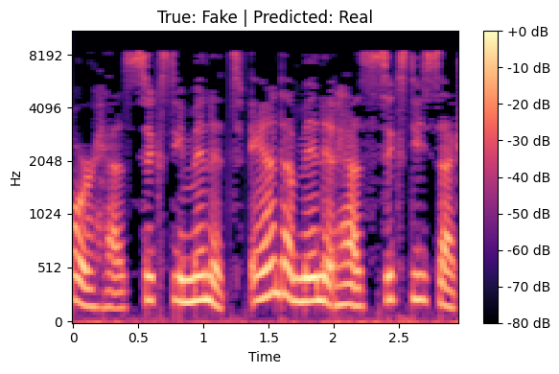
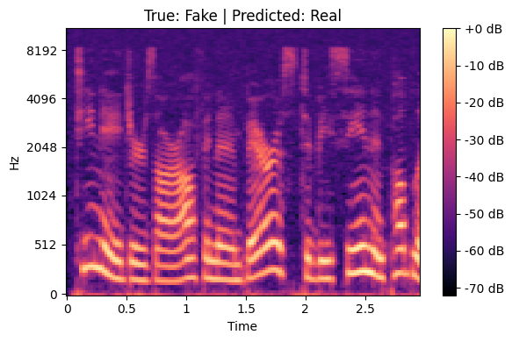
Model Errors (Misclassified Examples)
These examples show where the model struggles when real and fake patterns are similar.

Slide 12
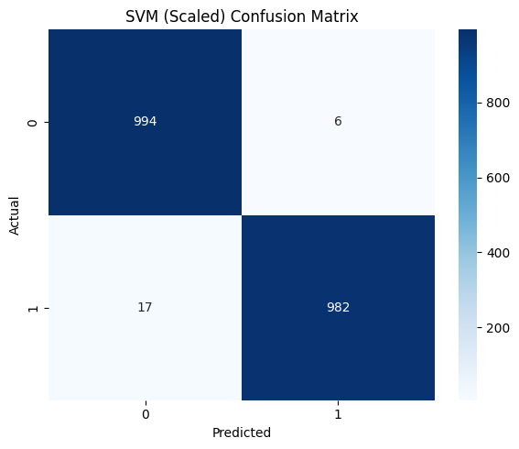
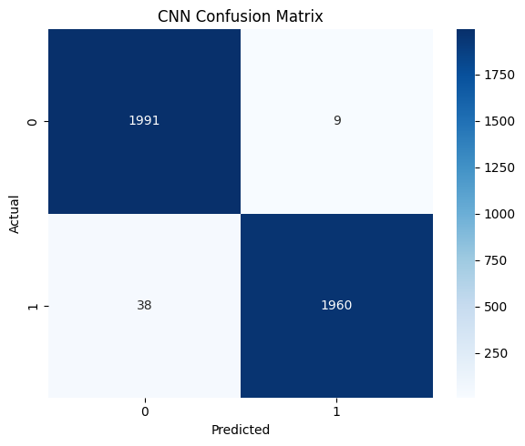
Confusion Matrix Comparison
Accuracy: ~98.84%
F1: ~98.84%
Accuracy: ~98.82%
F1: ~98.81%
SVM achieved better performance by leveraging MFCC features directly, whereas CNN struggled with limited data.

Slide 13
Specialized Datasets
MLAAD/
M-AILABS
ASVSpoof19
In-the-Wild
Less realistic, designed for lab testing
Contains the largest variety of deepfake techniques
5000 samples; 2500 fake, 2500 real
Real-world deepfakes
Sampled from internet videos and social media
2364 samples: 1182 fake, 1182 real
Foreign language dataset; German
Detecting English speaker bias
5000 samples: 2500 fake, 2500 real

Slide 14
Best Results/Models for Comparison
ASVSpoof19
In-the-Wild
MLAAD
Spectrogram CNN
Acc: 70.82%
EER: 28.68%
Spectrogram CNN
Acc: 66.67%
EER: 31.81%
SVM (Unscaled)
Acc: 77.66%
EER: 12.36%
Best at catching computer-generated deep fakes
Spots digital fingerprint features like sound quality
Generalizes the best on real-world data
Most resistant to background noise
Optimizes less features
Robust to different languages

Slide 15
Next Steps
Step 1
Step 2
Step 3
Step 4
Increase Dataset Diversity
Improve Model Robustness
Real-Time Deepfake Detection
Secure Deployment
Expand dataset with more voices, accents, and recording environments.
Train the model to handle noise, shorter clips, and varying audio quality.
Implement the model to detect fake audio in real time for security and fraud prevention.
Develop controlled systems for detecting deep fake audio in security and verification settings.

Slide 16

Conclusion
What we did
Results
Key Insight
Practical Value
Final takeaway:
Built a model to detect real vs fake (deepfake) audio
Compared multiple models:
Random Forest
Logistic Regression
SVM (w/ & w/o scaling), CNN (mel spectrograms)
Evaluated the models
SVM (Scaled) performed the best
Accuracy: ~98.8%, F1: ~98.8%
CNN also performed very well
Accuracy: ~98.7%, F1: ~98.8%
Other models performed slightly lower but pretty well
Feature scaling significantly improved SVM performance
MFCC features are very effective for detecting fake audio
CNN works well, but SVM with engineered features outperformed it
Deepfake audio is increasing in
Fraud, voice impersonation,
Misinformation, cybersecurity
This model shows we can accurately detect fake audio with high reliability
Best model: SVM (Scaled)
Traditional ML + good features can outperform deep learning for detecting deepfake audio

Slide 17
Thank You

